Slide 1
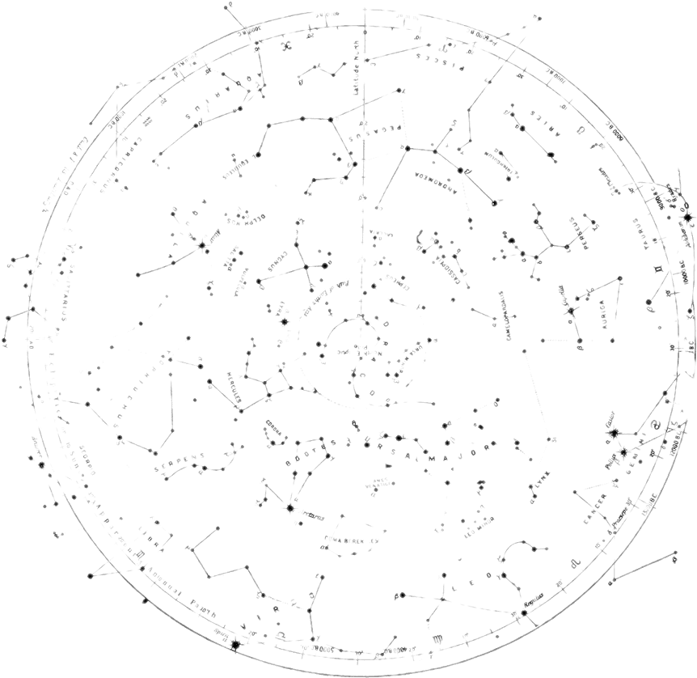

Board Design In Autodesk Eagle
THE SESSION WILL BEGIN SHORTLY
Presented by:
Jacob Lawson

Slide 2
Lesson Video Link
https://eu-lti.bbcollab.com/recording/3eba6015ec1b4492b52a514fc9174600

